Slide 1
Case Discussion
INFO 4940/5940:
U.S. Copyright Law
Mike Priehs – February 5, 2025

Slide 2
Agenda
01
03
02
04
Review
DC Comics v. Towle
Topics from this week
Derivative works
More about Photos
Star v. Varsity
Photos and videos of buildings and art works in public spaces
Copyright in fashion

Slide 3
01
Review

Slide 4
Subjects of Copyright
Literary works
Musical works
Dramatic works
Choreographic works
Pictorial, graphic, and sculptural works
Motion pictures and other A/V works
Sound recordings
Architectural works
                17 US Code §102

Slide 5
02
More about Photos
Freedom of Panorama

Slide 6
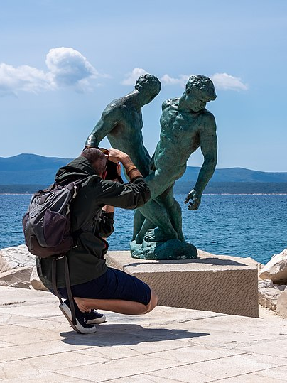
Freedom of Panorama
a provision in copyright law that allows individuals to take and publish photographs, videos, and other images of buildings, sculptures, and artworks that are permanently located in public spaces without infringing on the copyright of those works. This exception varies by country and typically applies to works in outdoor public places, though some jurisdictions extend it to indoor public spaces as well.
Jules Verne Times Two / www.julesvernex2.com, CC BY-SA 4.0, via Wikimedia Commons

Slide 7
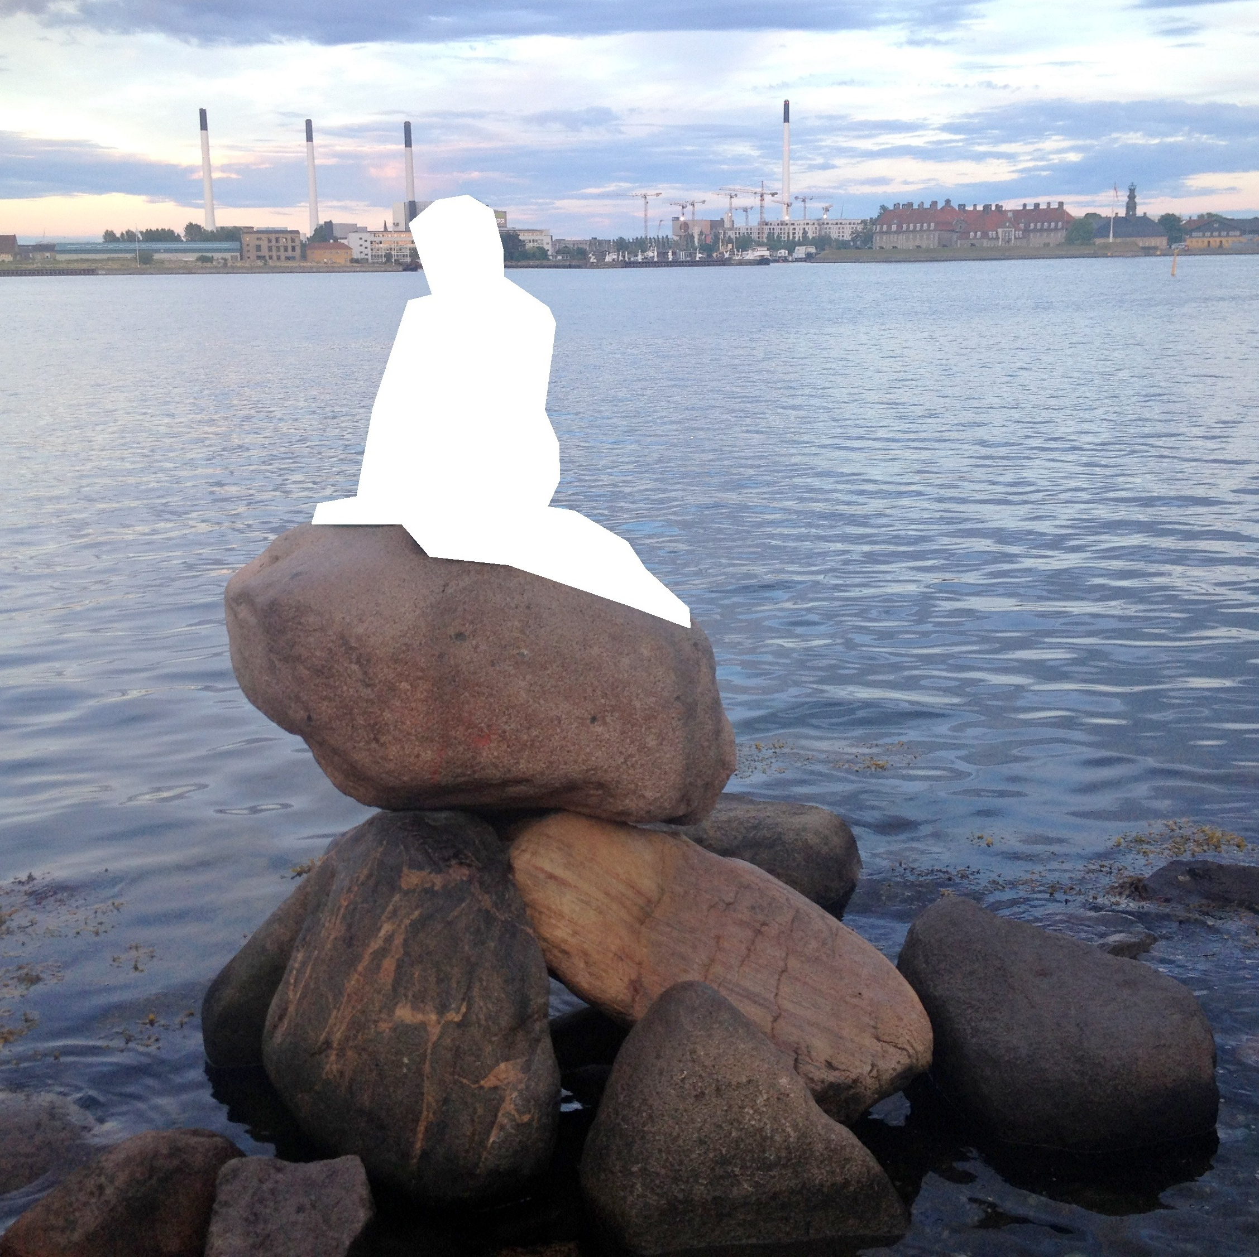
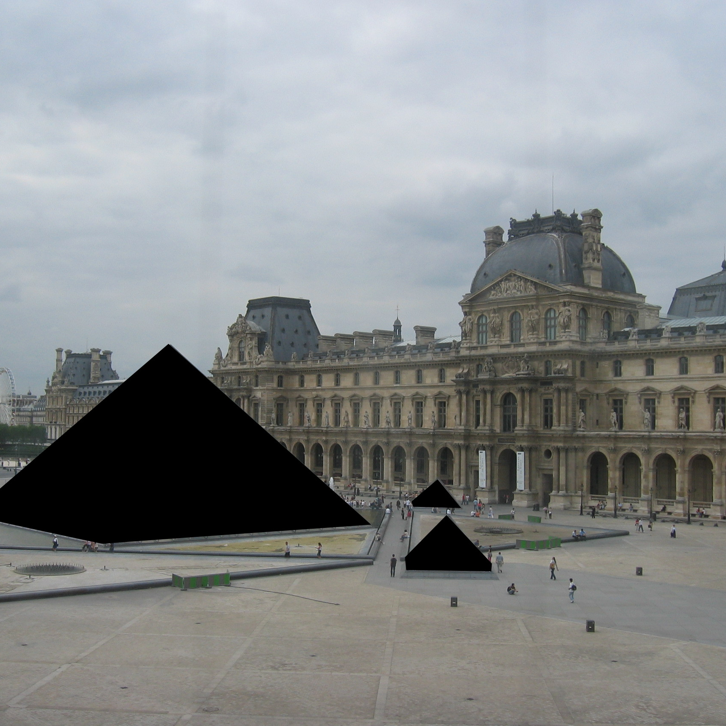
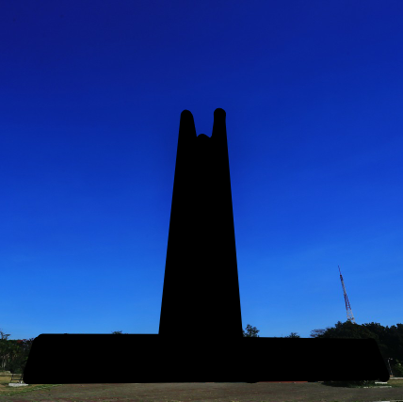
Some Examples
Denmark
France
Philippines
The Little Mermaid
Louvre Pyramid
Quezon Memorial Shrine

Slide 8
03
DC Comics v. Towle
United States Court of Appeals, Ninth Circuit (2015)

Slide 9
Case Background
DC Comics: A major comic book publisher and owner of the Batman franchise.
Mark Towle: Owner of "Gotham Garage," a business that produced and sold replicas of the Batmobile.
Issue: DC Comics sued Mark Towle for copyright infringement, trademark infringement, and unfair competition due to his manufacture and sale of Batmobile replicas.
Legal Action: The lawsuit was filed in May 2011 in the federal district court.
Notes:
Mark Towle owned Gotham Garage in Temecula, CA. Featured on a Netflix show called “Car Masters: Rust to Riches” in 2018.

Slide 10

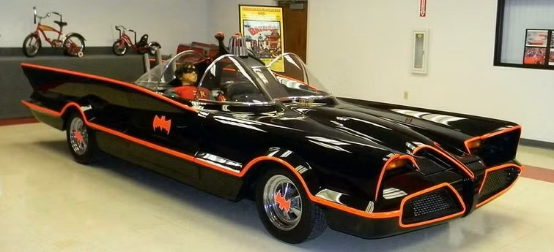

Gotham Garage’s Batmobile Replicas

Slide 11
Plaintiff’s Position
DC Comics
Claim:
  DC Comics argued that the Batmobile, as depicted in the 1966 television series and the 1989 motion picture, was a copyrightable character.
Basis:
  DC Comics claimed that Towle's replicas infringed on their copyright and trademark rights by copying the distinctive elements of the Batmobile.

Slide 12
Defendant’s Position
Mark Towle
Claim:
  Towle argued that the Batmobile was not a copyrightable character and that his replicas were not “substantially similar” to the original designs.
Basis:
  Towle contended that the Batmobile was a functional vehicle and that his replicas did not infringe on DC Comics' copyrights or trademarks

Slide 13
When is a character in a comic book, television program or motion picture entitled to copyright protection?

Slide 14
Decision & Significance
Court’s Decision:
Ruled in favor of DC Comics, stating that the Batmobile was a copyrightable character and that Towle's replicas infringed on DC Comics' rights.
Affirmed the district court's grant of summary judgment for DC Comics on the copyright and trademark infringement claim.
Significance of the Case:
Established that characters with distinctive elements, like the Batmobile, can be protected under copyright law.
Influenced how copyright law is applied to characters and their derivative works in various media.

Slide 15
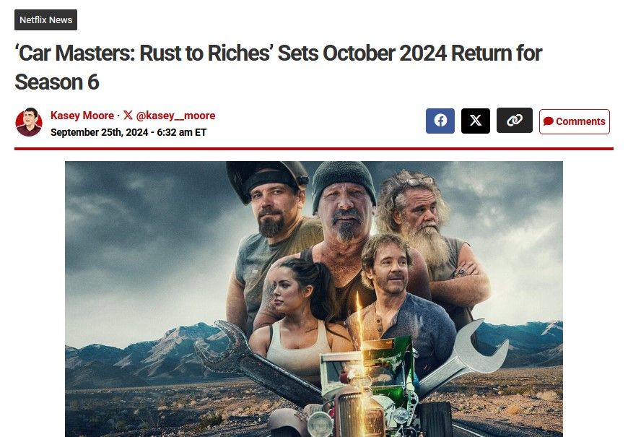

Slide 16
04
Star Athletica v. Varsity Brands
Supreme Court of the United States 580 U.S. 405 (2017)

Slide 17
Case Background
Varsity Brands, Inc.: Designs and manufactures cheerleading uniforms and accessories.
Star Athletica, LLC: A competitor that began creating similar cheerleading uniforms.
Issue: Varsity Brands sued Star Athletica for copyright infringement, alleging that Star copied the designs of their cheerleading uniforms.
Legal Action: The lawsuit was filed in the United States District Court for the Western District of Tennessee.

Slide 18
Plaintiff’s Position
Varsity Brands, Inc.
Claim:
  Varsity argued that their uniform designs, which included specific arrangements of lines, chevrons, and colorful shapes, were copyrightable.
Basis:
  Varsity claimed that these designs were original and separable from the functional aspects of the uniforms, thus deserving copyright protection.

Slide 19
Defendant’s Position
Star Athletica, LLC
Claim:
  Star Athletica argued that the designs were not copyrightable because they were integral to the functionality of the uniforms.
Basis:
  Star contended that the designs could not be separated from the useful article (the uniform) and therefore did not qualify for copyright protection.

Slide 20
Can the design features on a useful article, like a cheerleading uniform, be considered separately from the article's utilitarian function and thus be eligible for copyright protection?

Slide 21
Decision & Significance
Court’s Decision:
SCOTUS ruled in favor of Varsity Brands, stating that the designs could be perceived as two-dimensional works of art separate from the useful article and thus were eligible for copyright protection
The court established a two-prong test for determining the copyrightability of designs on useful articles.
Significance of the Case:
Established that aesthetic elements of useful articles can be copyrighted if they can be separately identified and exist independently of the article's utilitarian aspects.
Influenced how copyright law is applied to designs in the fashion industry and other fields involving useful articles.

Slide 22
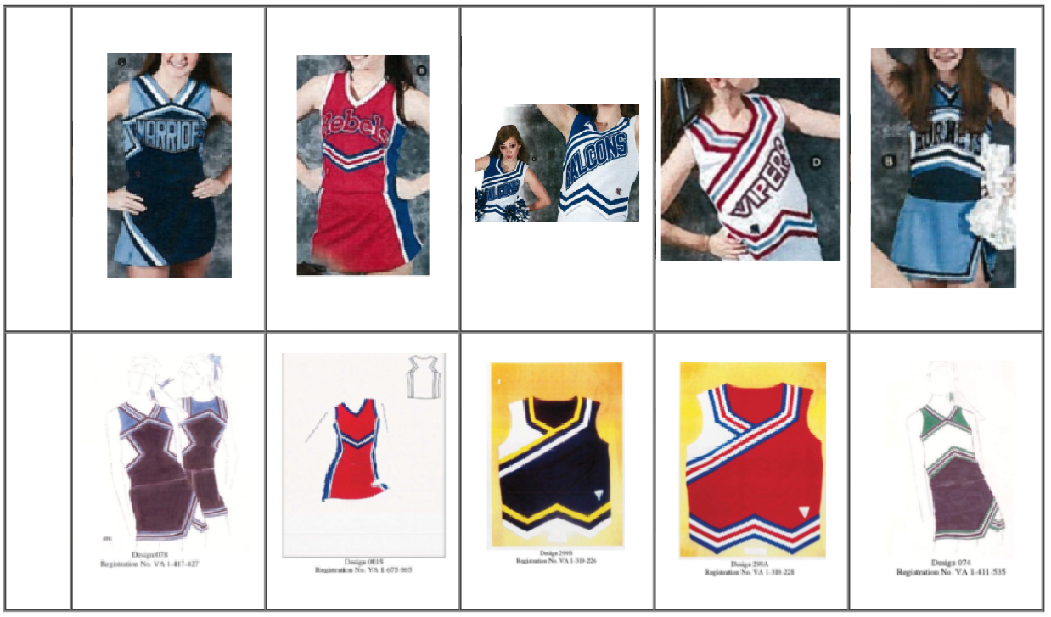
Star’s Accused Designs
Varsity’s Designs

Slide 23
SCOTUS Test
1
2
A feature incorporated into the design of a useful article is eligible for copyright protection only if the feature…
can be perceived as a two- or three-dimensional work of art separate from the useful article, and
would qualify as a protectable pictorial, graphic, or sculptural work—either on its own or fixed in some other tangible medium of expression—if it were imagined separately from the useful article into which it is incorporated

Slide 24
Questions?
Reflection #1 Due on Saturday @ 11:59pm!

